Slide 1
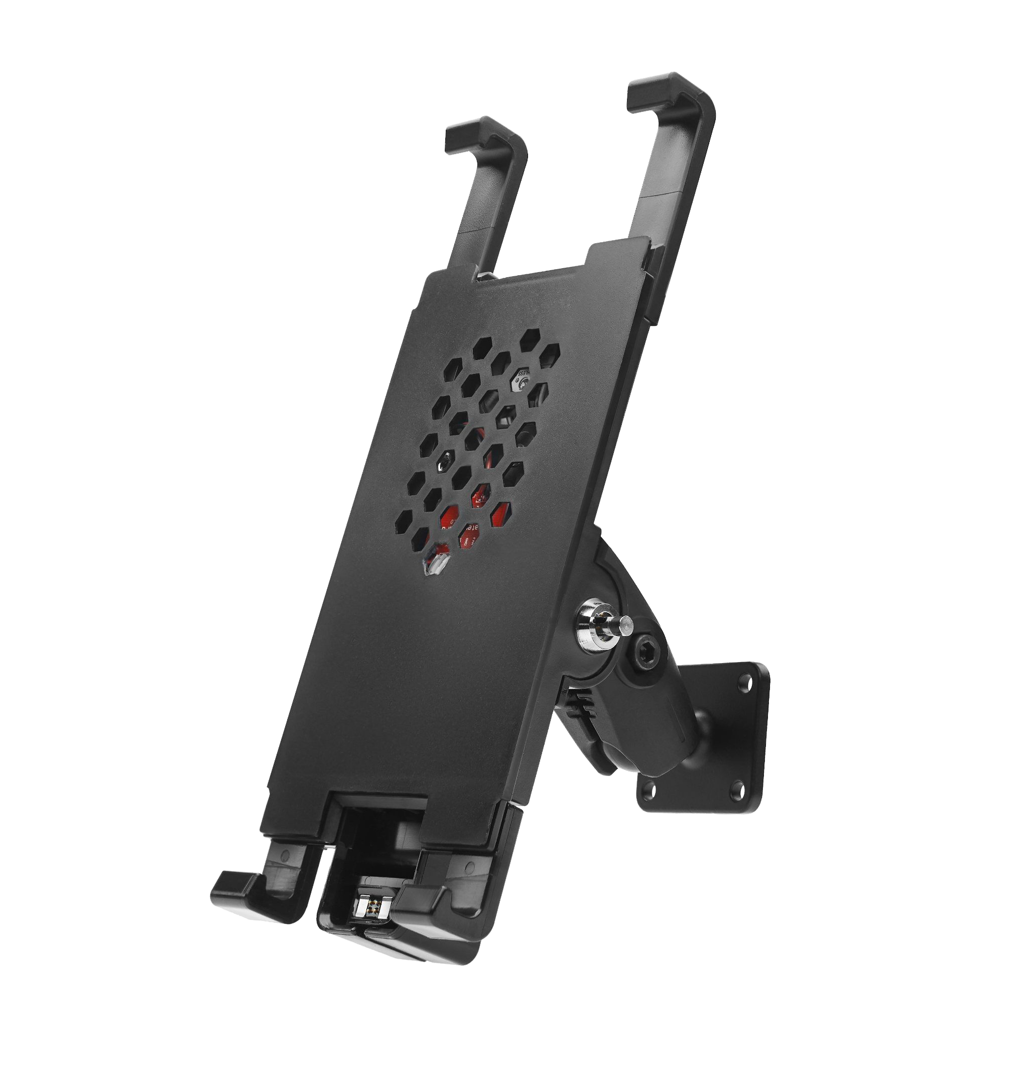
ATMOS by GPSLockbox
The only patented smart device mount that heats and cools your device in extreme temperatures

Slide 2
AT&T Billed
Our mounts and PTT kits are available as SKUs in OPUS and are ATT warehouse stocked
We are an AT&T billed national vehicle installation contractor for any client and any product
We are a Mobility SP
FirstNet and E-rate certified
All co-sell approved opps are eligible for Try before you Buy

Slide 3
All vehicle types
We make phone, tablet, and Push to Talk mounts for all verticals
School and transit buses
Long Haul, Medium, and light duty trucks
Forklifts
Police, Fire, and Ambulances
Passenger vans
Snowplows
Golf carts
Heavy Construction
Ready Mix
And more!

Slide 4
Peak performance
We have an exclusive patent to heat and cool a smart device
Help keep your customer’s devices operational even in extreme heat and cold when other solutions fail

Slide 5
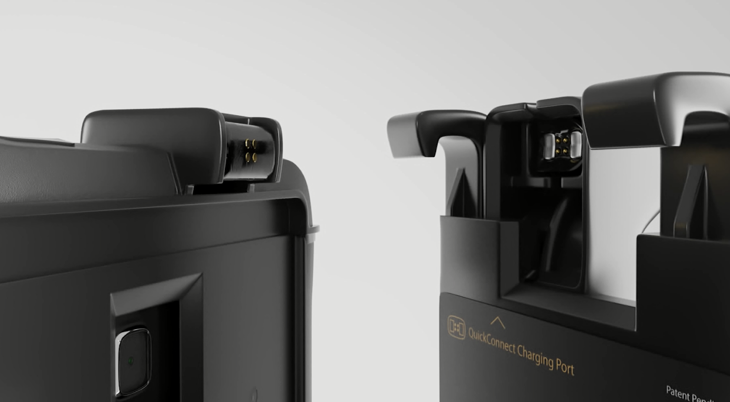
Rock-solid charging
We are also the only mount company that uses magnets and pogo pins for charging integrity in any driving situation.
Rural routes, rough streets, heavy duty vehicles, off roads, and more

Slide 6
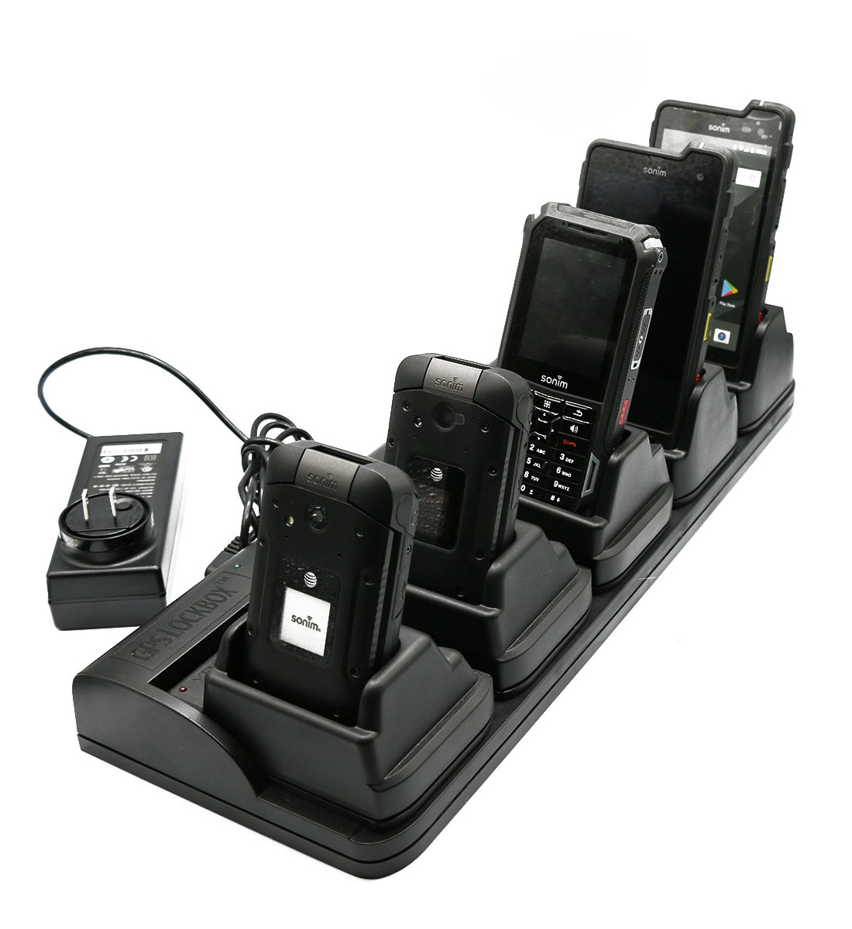
Charging Solutions
Charge different smart devices and spare batteries all at the same time using our innovative charging systems to help keep your clients ready to go.

Slide 7
Professional installation
Our national vehicle installation team can help deploy any hardware you want to empower your vehicles with
Fleet and Telematics solutions
Mounting equipment
PTT (push to talk) solutions
In vehicle and in building antennas
Access Points and mobile hotspots
Interior and exterior cameras
Lighting

Slide 8
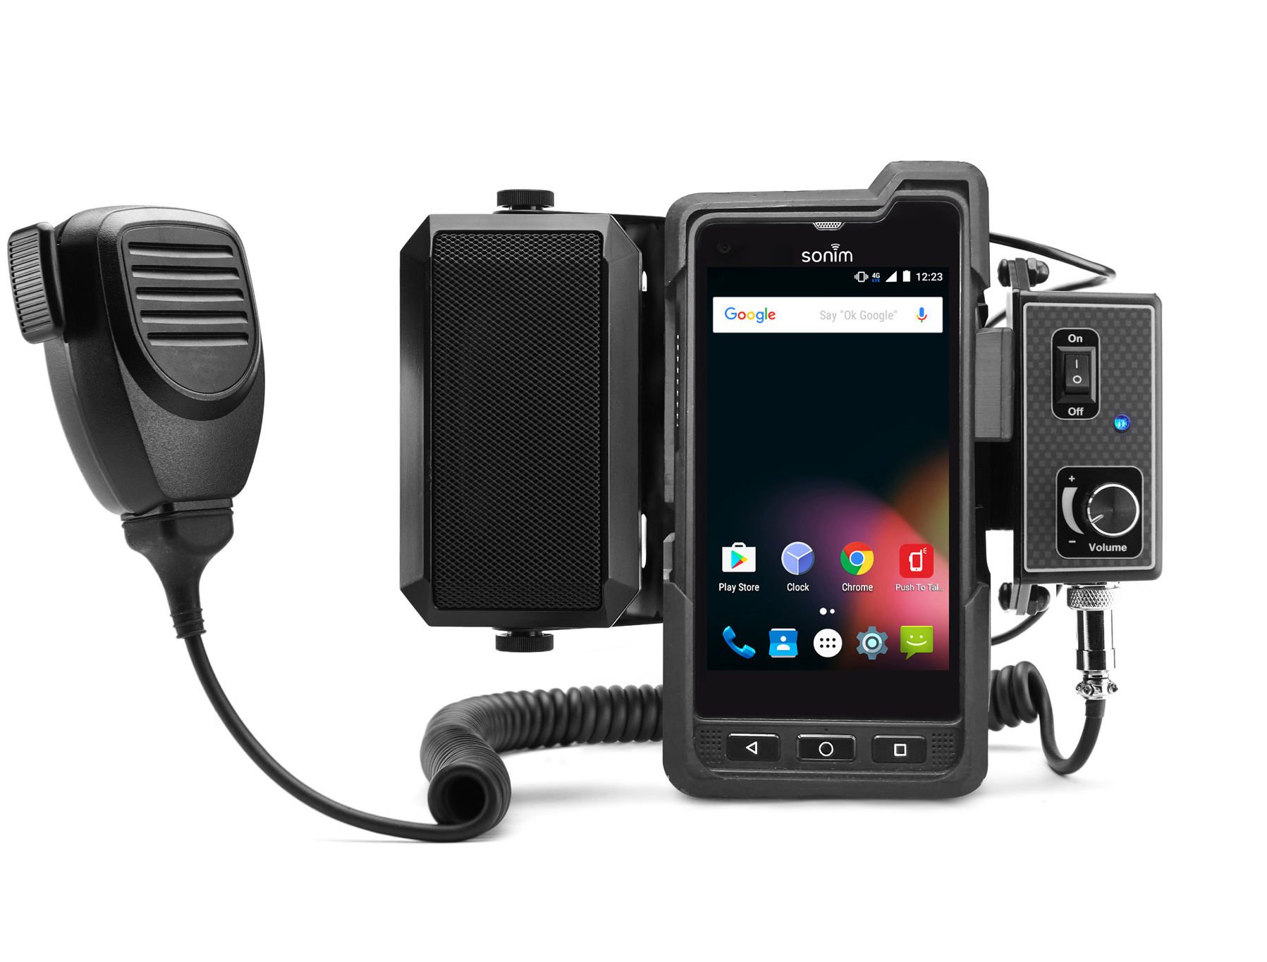
Partners
We support and enhance many hardware, carrier, and software partners globally

Slide 9
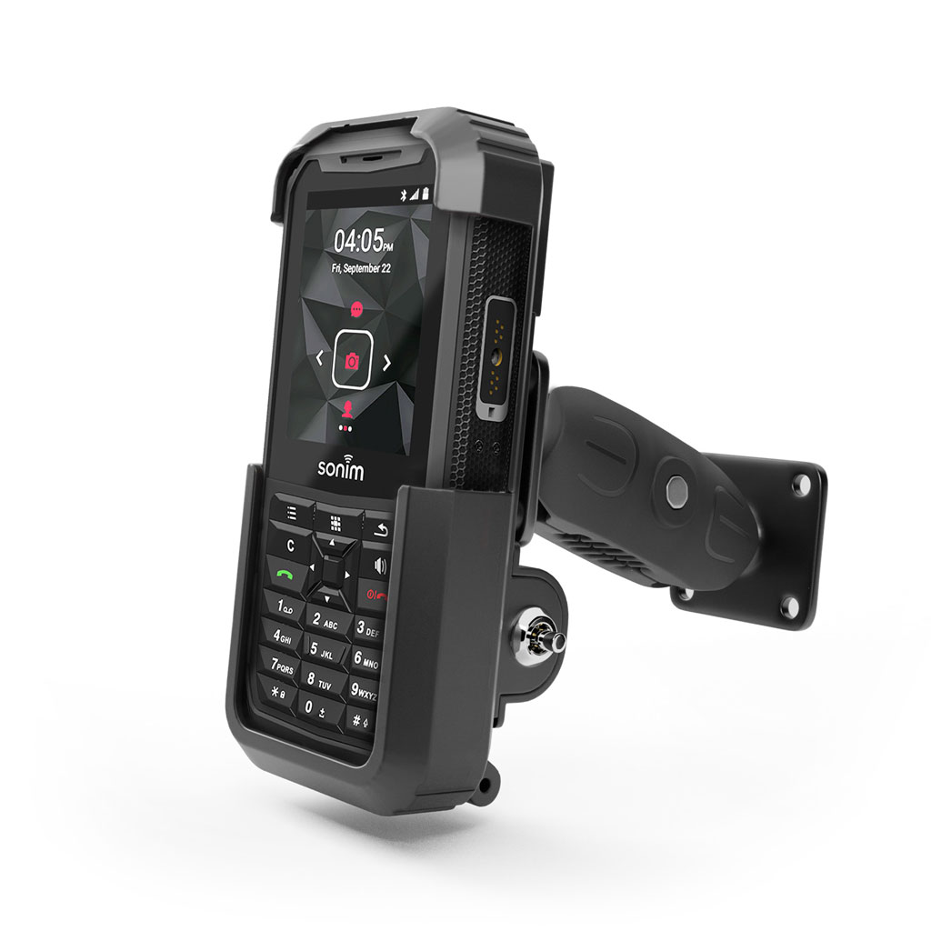
Let's talk
We are excited to partner
Web: GPSLockbox.com
LinkedIn: linkedin.com/GPSLockbox
Email: info@gpslockbox.com
Phone: 844.477.5625

